Slide 1
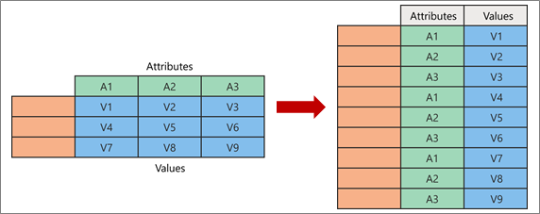
Pivoting and Unpivoting
Prepared By
Said Fawzy

Slide 2
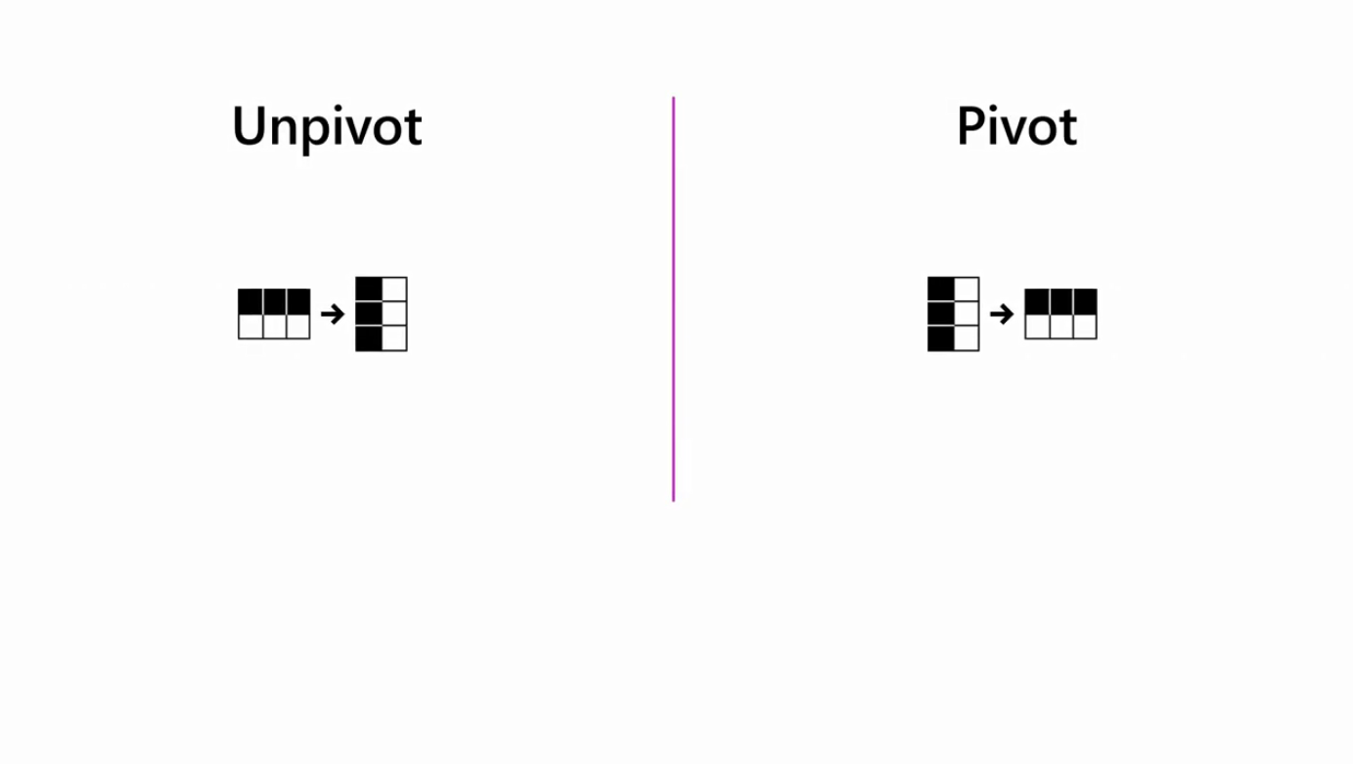
Unpivot and pivot operations are data transformation techniques that you can use to reshape and restructure data

Slide 3

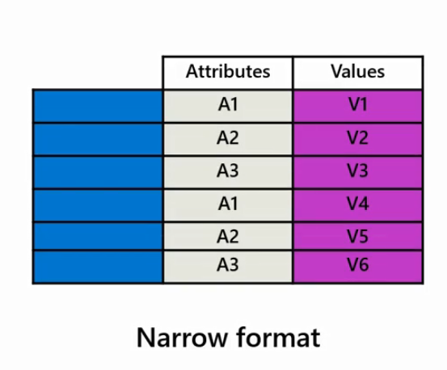
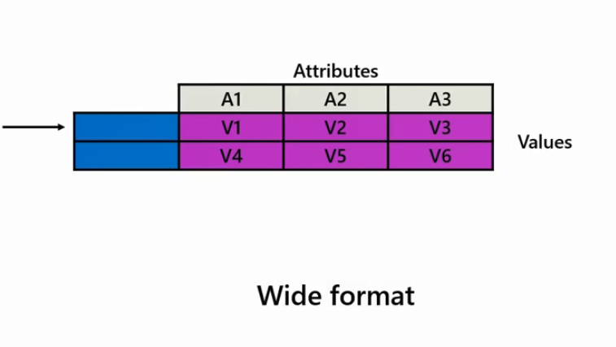
the pivot operation refers to the transformation of data from a narrow format with fewer columns to a wide format with multiple columns by reorganizing the data structure

Slide 4
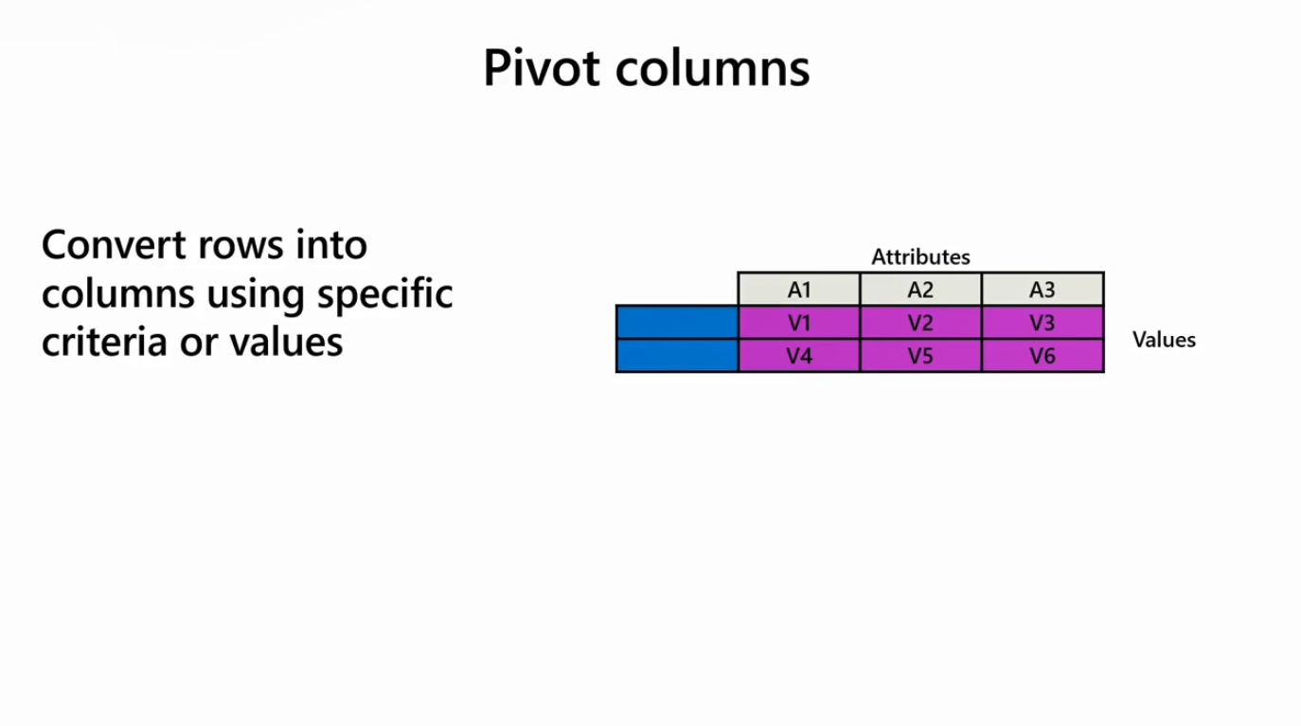
It enables data analysts to convert rows into columns based on specific criteria or values

Slide 5
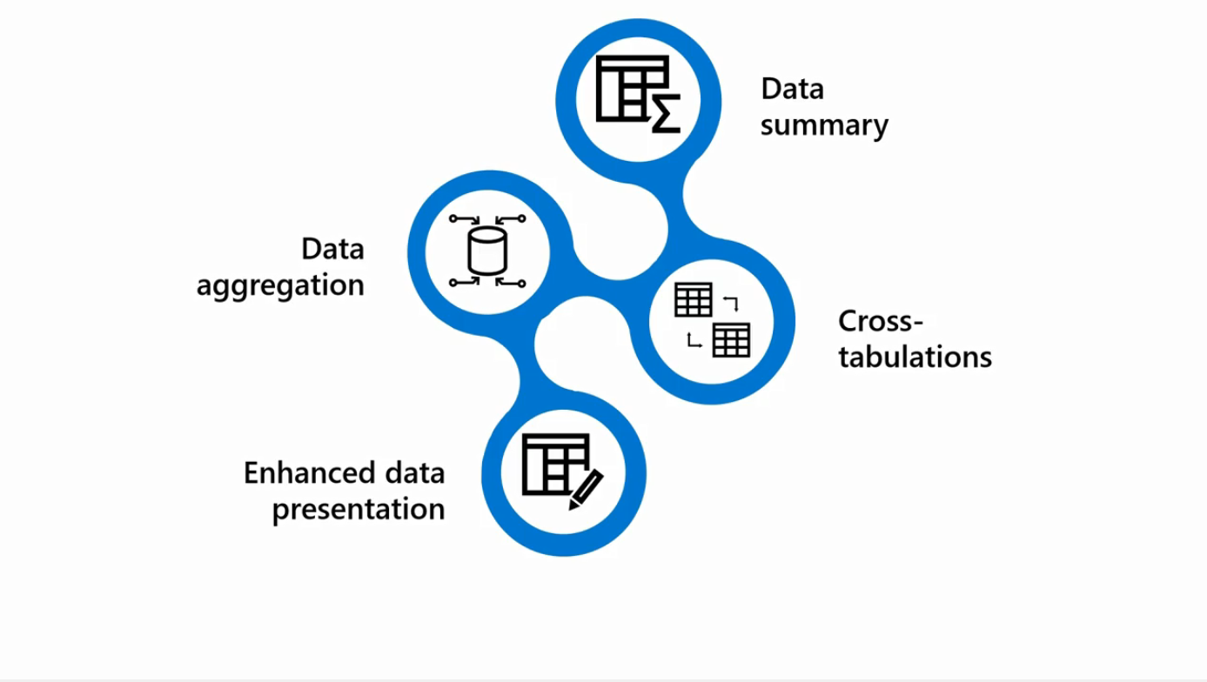
This operation is often used to summarize and aggregate data, create cross-tabulations, and represent data in a more structured easy-to-understand way for analysis and reporting

Slide 6
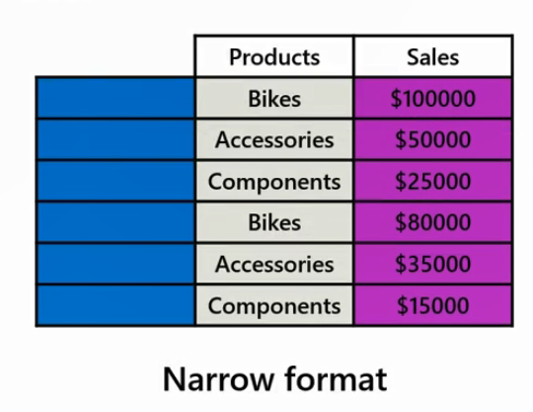
Example
say you want to analyze the sales data based on different product categories as part of the sales analysis

Slide 7
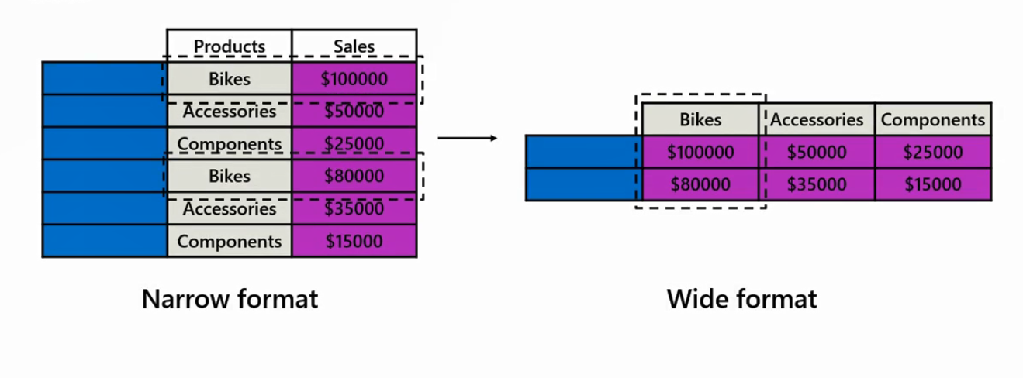
you can transform the rows containing individual product categories into separate columns.

Slide 8
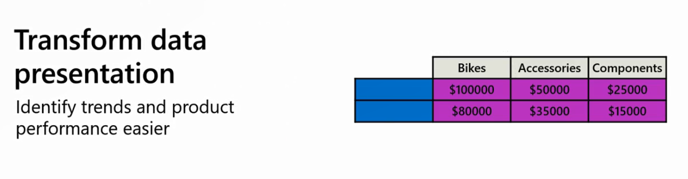
This pivot operation enables you to present the sales data in a more concise and structured manner, making it easier to identify trends, top-selling products, and performance within each category

Slide 9
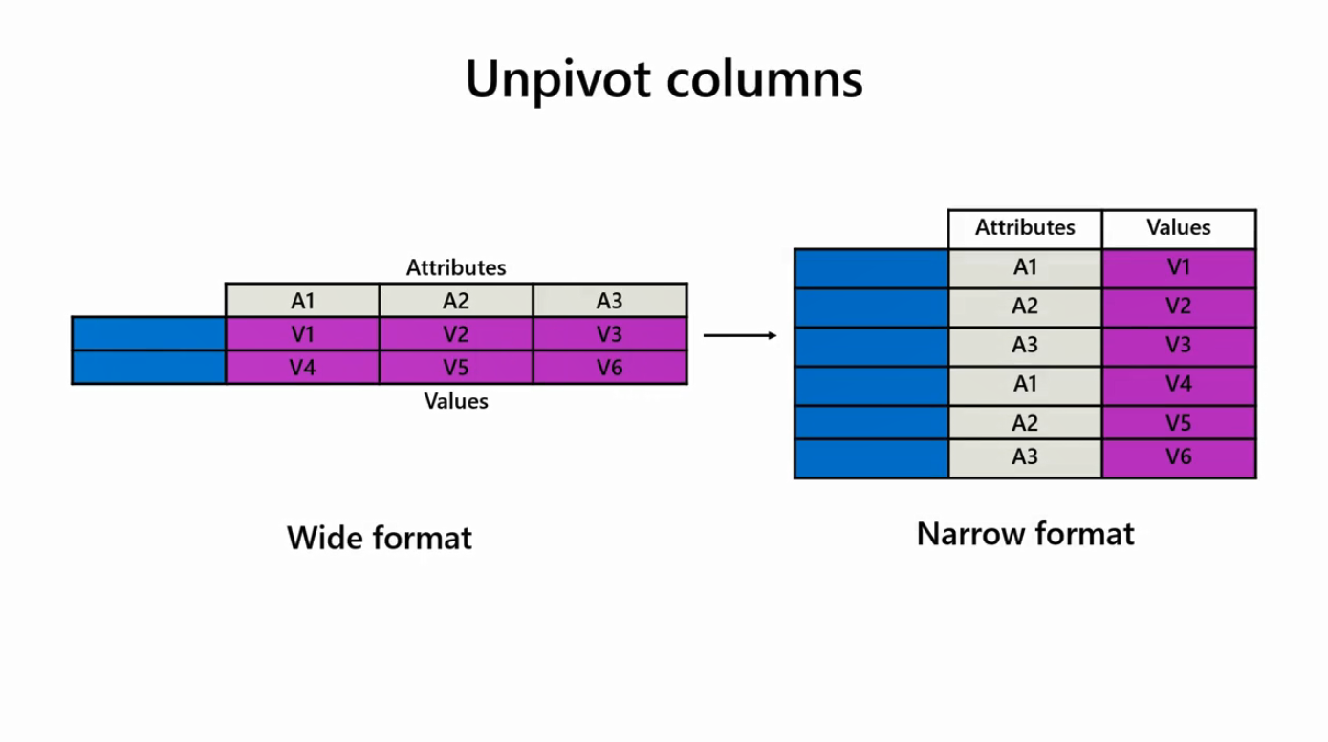
The unpivot operation refers to the transformation of data from a wide format with multiple columns to a narrow format with fewer columns by reshaping the data structure

Slide 10
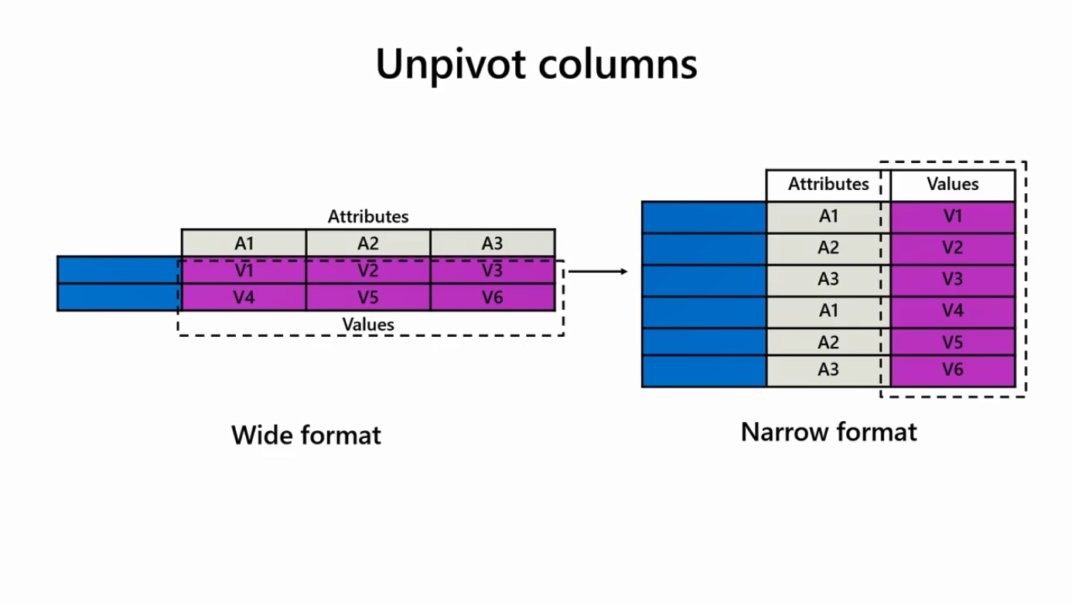
It involves converting column headers into row values resulting in a more structured and standardized representation of the data

Slide 11

The unpivot operation is useful in data analysis supporting data normalization by organizing data in a tabular format

Slide 12



This facilitates analysis, variable comparison, and data aggregation and summary as related information is consolidated into a single column

Slide 13

Transforming data from a wide to a narrow structure can also enable data compatibility and integration with other systems or tools that require a narrow format

Slide 14

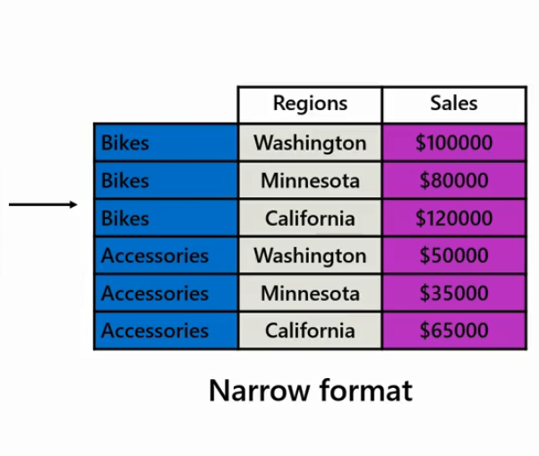
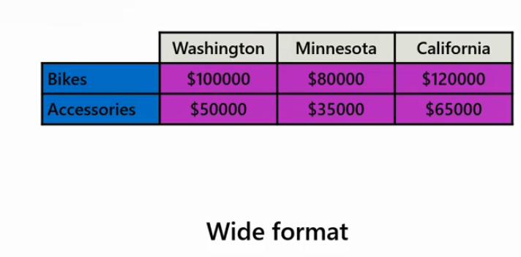
Example
you can perform the unpivot operation to convert the sales data, which is organized in a wide format with separate columns for each region into a long format where the region-specific data is stacked vertically in a single column

Slide 15
This makes it easier to compare sales across different regions and gain a holistic view of the overall performance

